Slide 1

EDA on Movies Dataset

Slide 2
Introduction:
The film industry plays a major role in the world-wide economy.
Every year more than hundreds to thousands of movies are released to the public audience with the hope that the movies getting released will be the next blockbuster.
The data given consists of valuable information on 999 hollywood movies such as Title,Year of Release,Director, Actors and also the revenue generated by them along with the runtime,rating and votes.
It also demonstrates the genre of the movie created on with a short description on the theme.
It is possible to derive useful insights from this dataset.

Slide 3
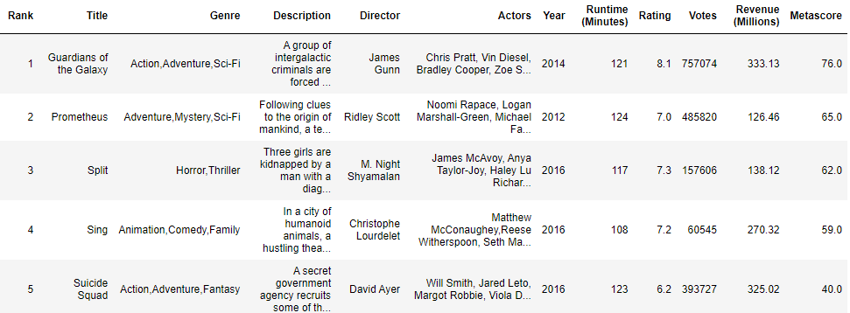
Sample Dataset:

Slide 4
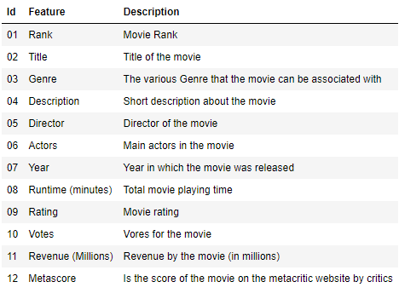
Feature and Description :

Slide 5
Problem Statement & Scenario:
Problem Statement:
In last few years, the film industry has become more popular than ever.
In 2018, movies made total income around $ 41.7 billion throughout the world.
But what genre of movies make the most money at the box office?
How much does a director matter for maximum revenue generation?
What genre of movies are least preferred by public to watch?
Scenario:
Moviemania, a movie theatre firm has number of branches in many places.
It also has its own ticket booking website to make tickets available for public to watch movies.
It is launched recently and gaining good attention from people for booking tickets.
Now the company wants to retain their customers and add more quality services.
To achieve this desired objective and tackle the problem they need a guidance in a most effective way.

Slide 6
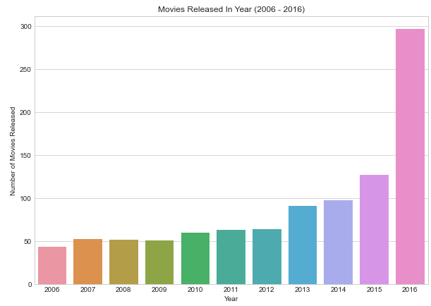
Number of movies released on each year
Maximum number of movies were released on year 2016 (297 movies) and least number of movies were released on 2006 (44 movies)

Slide 7
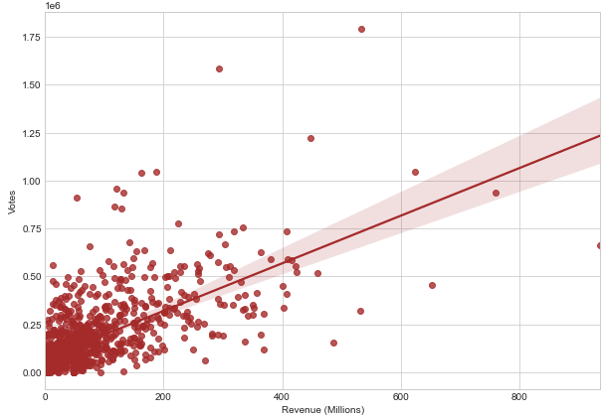
Relationship between Revenue (Millions) and Votes of movies
There is a strong positive linear relationship between Revenue and votes earned by a movie

Slide 8
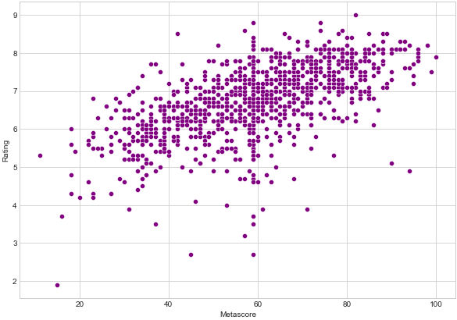
Relationship between Metascore and Rating of movies
Movies which had good metascore were also rated accordingly.

Slide 9
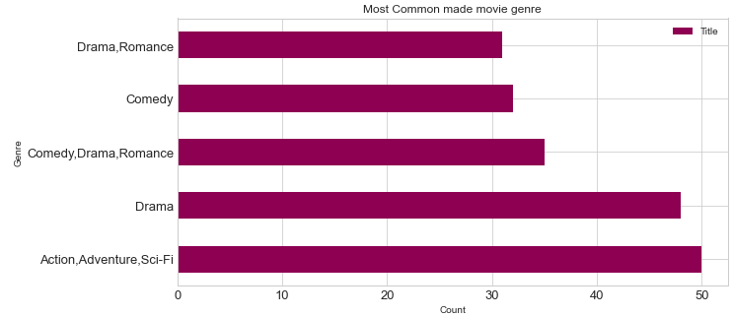
Genre on which most of the movies are made
Most of the movies are made on Action,Adventure,Sci-Fi genre commonly

Slide 10
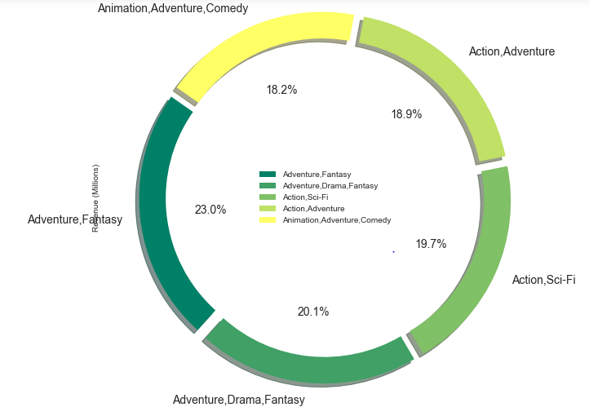
Genre of movies which had made more revenue on average basis
On an average basis, more revenue was generated from movies which was made on Adventure,Fantasy genre.

Slide 11
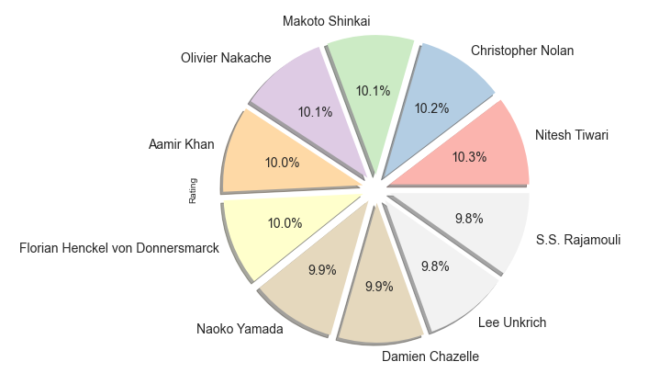
Top 10 highly rated movie directors
On an average basis,the director of highly rated movie is Nitesh Tiwari (8.80)

Slide 12
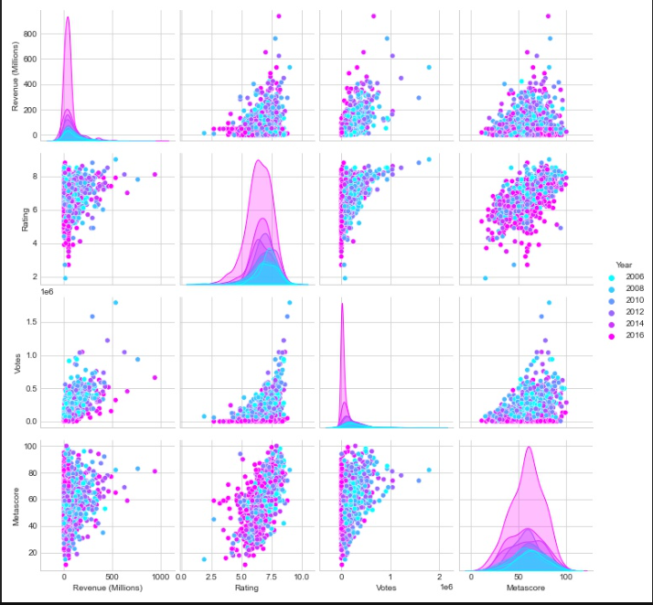
Relationship of Revenue,Rating,Metascore,Votes with each other
Revenue (Millions) has a strong positive linear relationship with Votes and Rating.
Metacore has very less positive relationship with Revenue and Votes because there are movies which has been highly rated but very low in revenue generation and votes too.
Votes are increasing as the rating increases.

Slide 13
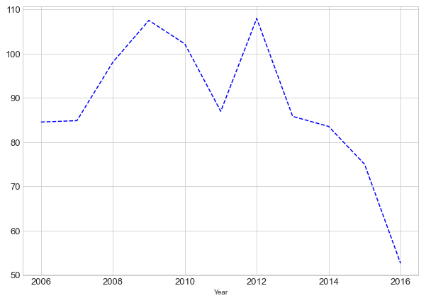
On an average, the year on which box office collected maximum revenue
Number of movies released is significantly higher in the year 2016 (297 movies) and therefore revenue was at top on this year but on an average basis ,good revenue earned was on year 2012 (107.973281 millions) with 64 released movies.

Slide 14
Conclusion :
From the analysis, it is concluded that :
More people turn out to watch the movies released since the rating given for movies year to year is gradually increasing.
There is a strong positive linear relationship between revenue generated and the votes earned by a movie.
And the rating given for a movie and metascore also keeps a positive linear relationship.
Most of the movies have runtime between 100 to 120 minutes still few outliers can be seen which is extended to 190 minutes.
Most common number of movies are made in genre 'Action,Adventure,Sci-Fi' but on an average good revenue generated movies are of 'Adventure,Fantasy' genre.

Slide 15
Actionable Insights:
From the analysis,it has been understood and suggested that :
It would be good if more tickets are issued for high rated directors’ movies as good number of people are expected
to collect tickets for it.
Movies are commonly made in 'Action,Adventure,Sci-Fi' genre and people tend to watch this type therefore it would be good if more seats and tickets are allotted for these genre of movies.
On an average ,high revenue earned movies are made of genre 'Adventure,Fantasy',so it is suggested to promote this genre of movies for earning high profit.
Most of the revenue generated movies are of runtime more than 120 minutes therefore,it is suggested to include more number of shows per day.
Movies made in genre : 'Adventure,Drama','Action,Biography,Crime','Adventure','Horror,Mystery,Sci-Fi','Animation,Comedy,Drama', earns less revenue therefore number of shows and tickets can be given accordingly.

Slide 16
Collaborate with educational institutions for attracting students to watch Adventure,sci-fi,historical theme based movies.(Discounts can be given for each batch of students)
Discounts can be given for bulk ticket booking and snacks can be given as freebie for it.
Option for changing the date and show time (only if available) for a booked ticket can be one of the best service provided for viewers.
SMS/Email notifications regarding seat availability for successfully running movies can be given for viewers.

Slide 17
Thank You

